Slide 1




NEXT GEN EMPLOYABILITY PROGRAM
Creating a future-ready workforce
Team Members
Student Name : Pradheep Vishal L
Student ID : au311121205044
Batch Code : 134
College Name
Loyola-ICAM College of engineering and technology.

Slide 2

CAPSTONE PROJECT SHOWCASE
Project Title
Music Web Application using Django Framework
Abstract | Problem Statement | Project Overview | Proposed Solution | Technology Used | Modelling & Results | Conclusion

Slide 3
Abstract
This study is aimed at developing a Web Based Music Portal which can be used to manage a musical library and a picture gallery. It is aimed to replace the manual system of getting musical CDs considering the technology advancement.
The implementation of the system is done using Django with extended support of Html,CSS,Javascript and MYSQL.
It has an extended view of a normal music application which includes more functionality based features.
Bootstrap plays a major role for creating various part of the web pages like cards,slider and etc..,
Source :

Slide 4
Problem Statement
Uniqueness of my project is that having favorite button for every song and displays it in the separate web page.
Administrator dashboard using Django makes easy to upload the data.
Can have multiple user to use the mobile web application.
It allow the user to view the page after the authentication.
Mainly,It have listen later option to listen the music later as they want.
Source :

Slide 5
Project Overview
My project consists of multiple pages.
Register page - To sign up in the application as a new User.
Login page - To sign in as a old User.
Home page - To view all songs and we can listen.
Category page - To display all the category.
Trending Page - To display trending songs.
Favorite page - To display the song which is favorite to the user who is logged in.
Listen later page - To display the song which is selected as listen later.
Logout option to logout
Main feature is that authenticated user can enter the home page.
Source :

Slide 6
Proposed Solution
.
In this project,we can listen the song and download the song in easy way.
We can also control the playback speed.
Easy navigation.
We can also know the details of the song like singer,writer,composer and also the descriptions.
The app doesn’t log out as long as we doesn’t press the logout button.
We can also search the song by their name.
Source :

Slide 7


Technology Used
Front-end
Back-end
Source :

Slide 8
Modelling & Results
Project database consists of category,songs and favorite.
The results comprises the home page with songs , proper user registration in register page,user authentication in login page,songs in favorite page & listen later page,category in category page,navigation from category page to song page which displays the song with specific category and search bar which searches the song and display.
Reverse navigation also possible.
Controls of the audio and download option is available with the song details.
Source :

Slide 9
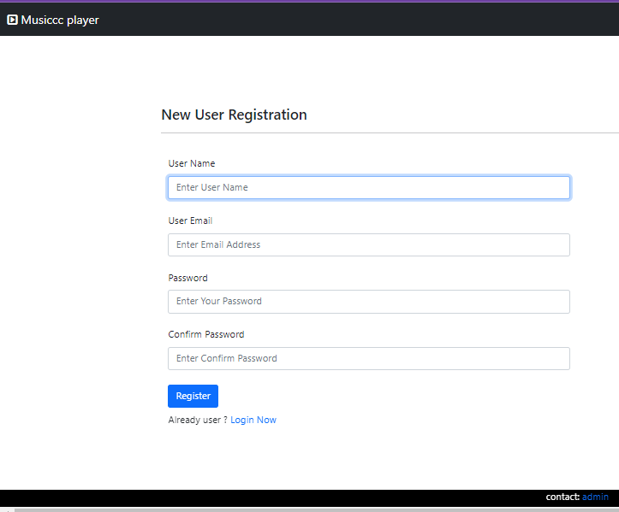
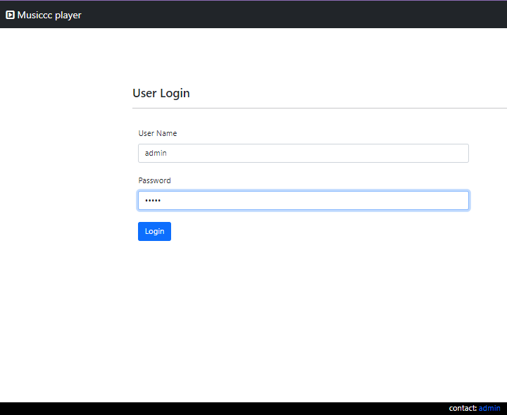
Register page
Login page

Slide 10
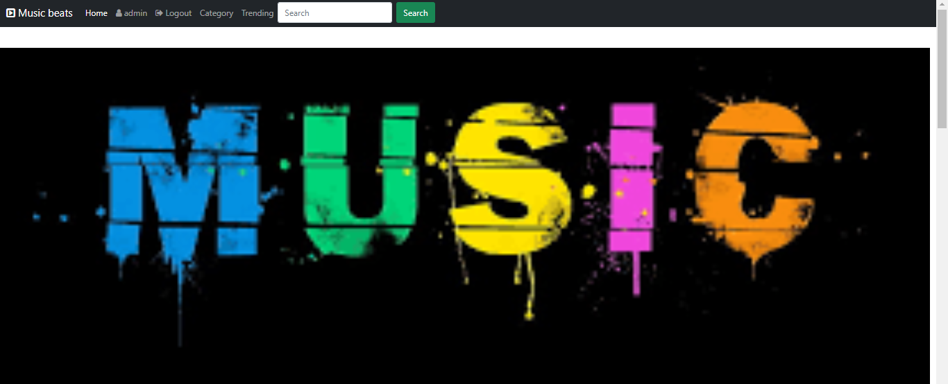
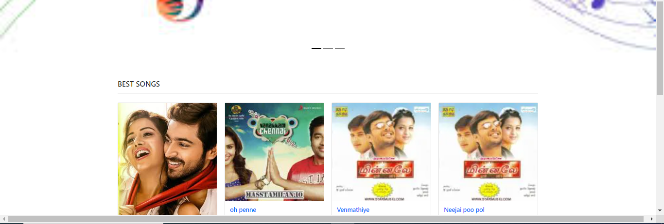
Home page

Slide 11
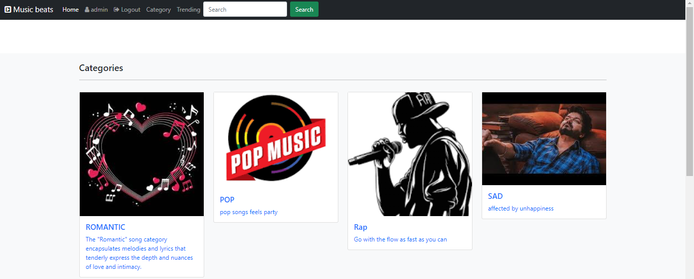
Category Page

Slide 12
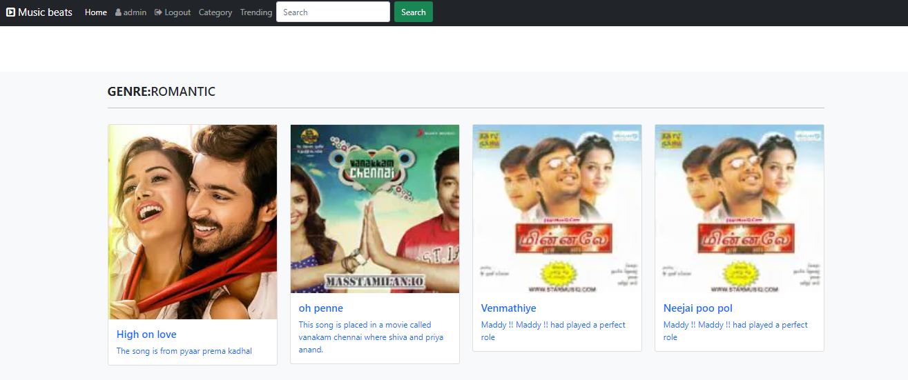
Genre Page

Slide 13
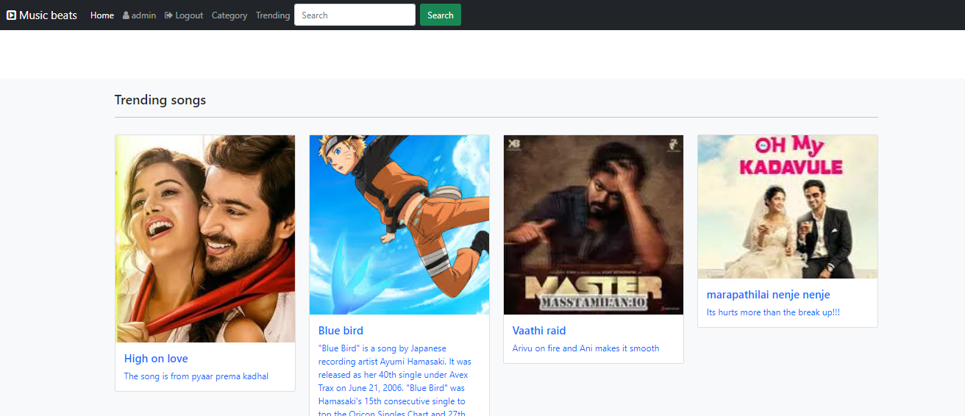
Trending Page

Slide 14
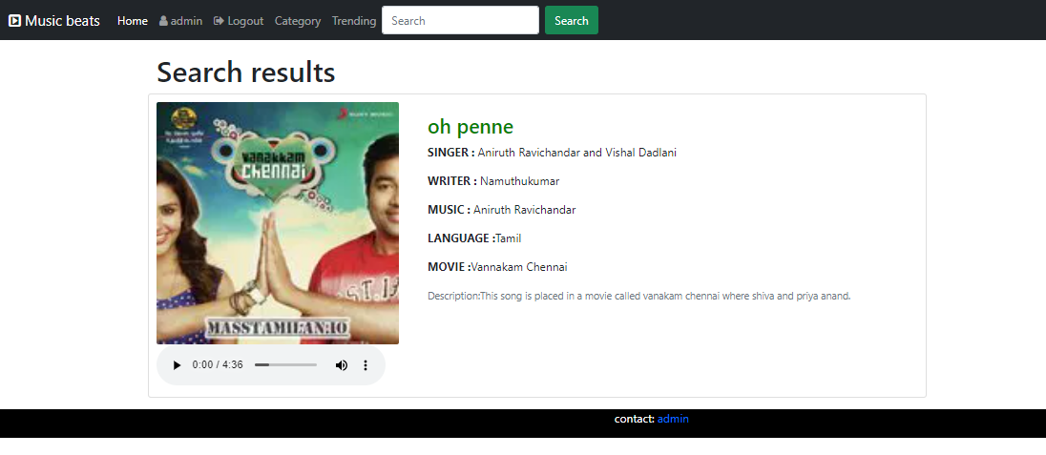
Search result Page

Slide 15
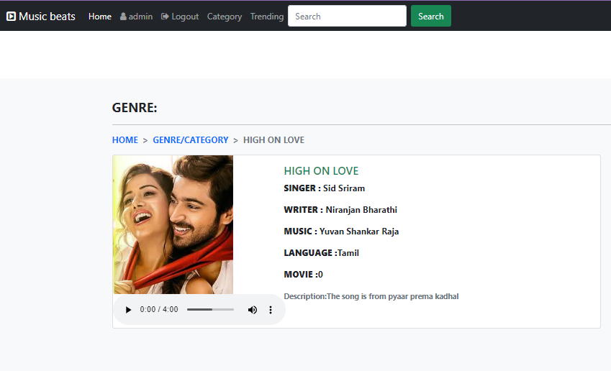
s
song Page

Slide 16
Future Enhancements:
In future ,we can have filter option to select song based on writer,singer and composer.
We can modify the style of elements as per the Trends in future.
We can also add features like motion pictures,reels from instagram to make our web applications prettier.
We can make user with different permissions (i.e)Premium package with the exchange of small price and they can download the paid version of songs.
Also we have to add single sign in method(i.e)By clicking google account we have to be login in the user to our app.

Slide 17
Conclusion
I made a try to get the favorites and trending song in their respective pages.
The adding of urls and everything plays a big roles in easy navigation.
The images are uploaded in the new folder called static will leads to easy retrieval of images,styles and files etc..,
Source :

Slide 18
Thank You!
Notes:
Thank You !!

